Slide 1
Finding Inefficiencies in Airbnb Markets
Rafi Kurlansik, ACSS Industrial Market
October 26, 2017

Slide 2
Agenda
Introductory Overview
Solution:
Architecture
Key Challenges
Demonstration
Conclusion

Slide 3

DEMO – Finding Inefficiencies in Airbnb Markets
WOW Card
Use Case: Data Scientists can model the price of Airbnbs in a geographic market to identify inefficiencies, thereby maximizing profits for property owners and minimizing costs for renters.
Who
WOW
Persona(s) | Business Problem Statement(s)
Data Scientist, Business Analysts | How can I model the price of an Airbnb market in a way that identifies mispriced listings?
C-Suite Executive, LOB Leader | How do I intelligently price my assets against the market?
Industry Application: Cross-industry, Retail
Business Value
Carefully modeling prices of Airbnbs allows property owners to intelligently price their assets so they are neither priced too high or too low, maximizing their profits. The same model also allows renters to select good deals and avoid overpriced listings, putting more money in their pocket. This is an example of practical machine learning for business and the value add of IBM’s cognitive technologies.
What
How
Use Case Overview
As an Airbnb renter it’s hard to know when you are getting a good deal. Additionally, how should you best price your property when you list it with Airbnb? How can data science help us solve these problems? In this demonstration we use data from real Airbnbs in Portland, OR to model the effect of location and property size on final listing price. We deploy the model into an ‘Airbnb Explorer’ app that allows renters to find better values and property owners to accurately price their assets. Finally, we add a cognitive element by sending the reviews of each listing to Watson APIs, extracting the top keywords to get a snapshot of what staying there might be like.
Implementation
Demo Highlights: The entire project was done inside Data Science Experience – the data was gathered from the community, prepared using Jupyter, the model deployed with Watson Machine Learning, and the app built using RStudio. The demo shows how DSX supports an end to end data science workflow.
Demo Components: DSX, WML, Watson NLU
Author(s): Rafi Kurlansik, ACSS Industrial Market (rafi.kurlansik@ibm.com)
Internal: Yes BP Facing: Yes Customer Facing: Yes
Notes:
State Use case
Who? Cross industry pricing exercise
What?
WOW – Taking advantage of pricing inefficiencies in a market and using IBM value add to enrich applications
How – really an end to end data science workflow without ever leaving DSX.

Slide 4
Solution Architecture: Watson Data Platform & Data Science Experience
Notes:
- DSX is best understood as part of the larger vision of WDP, so allow me to set the context here [next slide]

Slide 5










Turning Data into Insights is a Team Sport
Watson Data Platform
Data steward
Data scientist
Data engineer
Business Analyst
Developer
Clearly Articulate Use Case
Gather all the Data
Prepare Data
Digital
Application
Apply Machine Learning
Evaluate
Notes:
It requires a team of people to build quality data products
Not only that, but they each play a part in the execution of the workflow you see here
Take note of the flow here because these are the steps that I followed when building this solution
I built this solution mostly by myself, but figuratively speaking I had to wear many hats
[articulate the flow with personas]

Slide 6
How We Used Watson Data Platform to Win
Watson Data Platform
Self Service Experiences
Watson Analytics
Smart discovery & exploration
Data Science
Experience
Collaborative data science
Data Refinery
Data preparation & integration
Watson APIs
NLU, Personality Insights, Visual Recognition, etc.
Data Catalog
Data & analytical asset organization
with governance
Data Movement and Processing
Lift
Grount-to-cloud transfer
Analytics Engine
Hadoop & Spark
Watson Machine Learning
ML processing & management
Message Hub
Kafka
Streaming Analytics
Analytics for data-in-motion
Data
Object Storage
Redis
Graph
Mongo
Cloudant
Postgres
DB2 on Cloud
DB2 Warehouse
on Cloud
…
Notes:
Let’s spend a moment on this slide - this is how the different pieces of watson data platform are logically related to eachother, and you can think of this as your “solution architecture” slide
At the bottom layer underpinning everything is data, and WDP supports integration with a broad set of structured and unstructured sources
In the next layer is how we treat data that’s in motion – moving through applications or to and from repositories
Above this is the ‘experiences’ layer, where we have software designed for specific personas on the advanced analytics team
So, WA for the business analyst, DSX for the data scientist, and so on.
Finally, tying it all together is the data catalog on the right. This is the technology that allows for the indexing and governance of data & assets as they flow through the platform.
I’ve highlighted the services I’ve used in green
The data was in Object Storage
I deployed and manage one of my models in WML – when users interact with my application the data is sent to WML, scored, and a prediction is returned and rendered to the user.
I wrote my code and built out my project in DSX
And finally I leveraged Watson APIs in my code to infuse the digital application with our cognitive secret sauce.

Slide 7



Key Challenges
I. Demonstrate the practical business value of machine learning
Use real world data to show how data science improves the bottom line.
II. All work must be done in DSX on IBM Cloud
The stages of development for a cognitive app with a predictive model - finding the data, analyzing it, modeling it & enriching with Watson APIs – all must be built inside DSX.
III. Model Deployment with Watson ML & Open Source
Go beyond merely training a model and deploy it on the cloud.
Notes:
So what were some of the constraints surrounding this solution?
First, real data had to be used, and therefore real insight and business value needed to be extracted.
Second, all of those stages of development had to be done in Data Science Experience. This really forced me as a user to pull value from the various features that can be found in it.
Third, show how IBM embraces open source and builds upon it to provide enterprise-grade functionality.
I chose to do this by showing how models can be deployed into applications in different ways.

Slide 8
Demonstration Follow along: http://tinyurl.com/airbnbNotebook
Notes:
Let’s get into the demo now – once we get to the Jupyter Notebook you can follow along by navigating to the URL above in your browser. It’s tinyurl.com/airbnbNotebook

Slide 9
Conclusion

Slide 10
Key Successes
I. We demonstrated the practical business value of machine learning
By using real world data to show how data science improves the bottom line.
II. All stages of workflow were executed in DSX on IBM Cloud
Setting up the project, finding the data, using notebook as narrative, enriching web apps with Watson APIs – all were built and managed inside DSX.
III. Operationalized models with Watson ML & Open Source
Trained & deployed predictive models via WML and open source.
Notes:
So let’s summarize:
In case you have an audience who is still unaware or doesn’t grasp the practical value of machine learning, we’ve clearly demonstrated that here.
We showed how the data science “IDE” that IBM has built in the Cloud is well suited to rapidly craft these solutions and infuse them with cognitive.
Finally, we further established the value add of WML and DSX by going beyond simply training a model to deploying it to the cloud. This made it easy to manage and integrate into our digital application.
It’s tempting to say that the biggest takeaway here is that DSX is a great place to do end-to-end data science work. And it is! But that would be missing the bigger picture, which is that DSX is part and parcel of the Watson Data Platform vision. What you saw was really only one experience on WDP – think about that… There are others, and they are rich in their integrated functionality as well. [next slide]

Slide 11
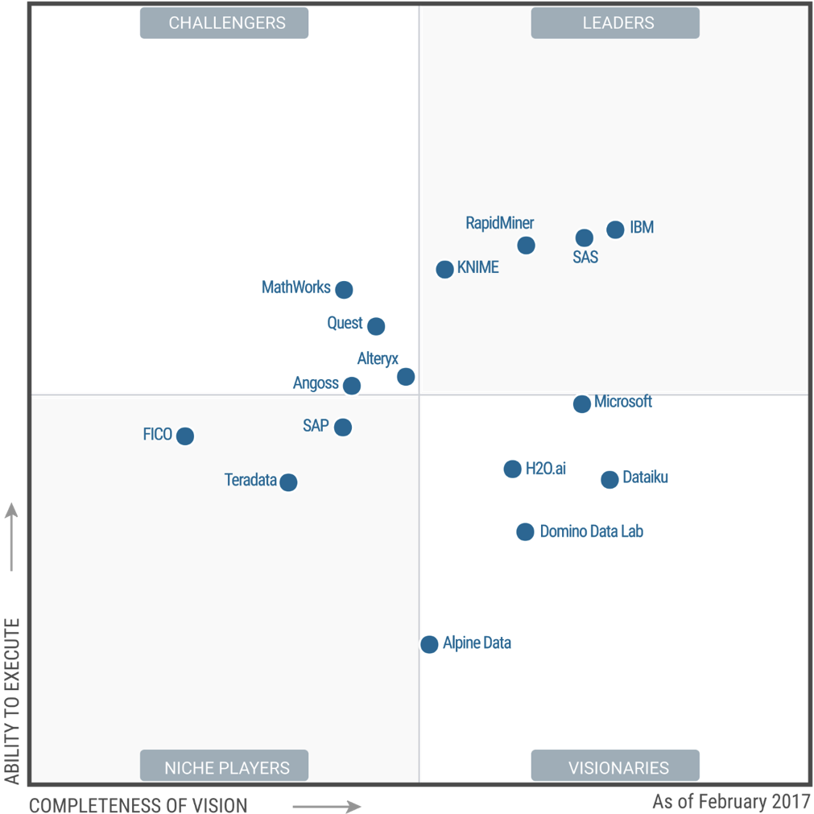
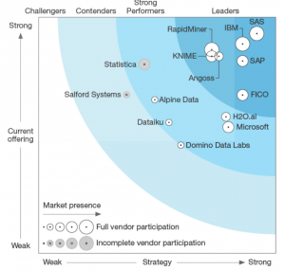
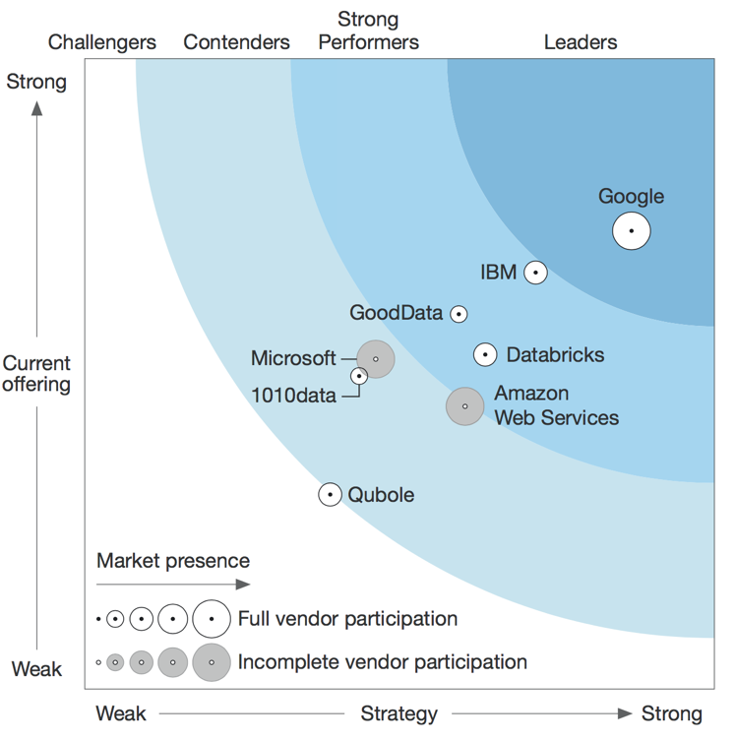
Finding Inefficiencies in Airbnb Markets – Playing to IBM Strengths
Gartner Magic Quadrant 2017
Data Science Platforms
Forrester Wave 2017
Predictive Analytics & Machine Learning
Forrester Wave 2017
Insight Platforms-As-A-Service
IBM is positioned as a Leader in the 2017 Gartner Magic Quadrant for Data Science Platforms, based on its ability to execute and completeness of vision.
IBM is positioned highest in execution and furthest in vision within the Leaders Quadrant.
This is the fourth consecutive year for IBM to be recognized as a leader in this report.
Source: https://www.gartner.com/doc/reprints?id=1-3TKD8OH&ct=170215&st=sb
http://www.developerweek.com/awards/2017-devies-award-winners/
Notes:
So then the biggest takeaway is that we can confidently tell our clients that IBM has built something special with WDP and DSX, something that enables their teams and organizations to be more effective and competitive. And as you can see the industry analysts validate what we believe internally, giving us recognition for Data Science, Machine Learning, and “Insight Platforms-As-A-Service”
I’ll conclude by saying that I am personally excited for the launch of WDP 2.0 next Thursday – I think the introduction of Data Catalog and the general maturation of DSX & WML are a winning combination, and hopefully this demo and the message it carries resonates with our clients. [next slide]

Slide 12
Thank You!
Questions? Contact me!
Email: Rafi.kurlansik@ibm.com
Additional Resources:
Airbnb Notebook: http://tinyurl.com/airbnbNotebook
Shiny App: https://kurlare.shinyapps.io/airbnbml/
Watson Developer Cloud: https://www.ibm.com/watson/developer/
Watson NLU in R: http://tinyurl.com/watsonNLUtoR
R4WML: https://github.com/IBMDataScience/R4WML

